Slide 1
FarmIQ : Data-Driven Farming Solutions
Team Members:
Mamtha M Vathar Ramya T Gowda Emmanuella Nyamekye Akash K R Aarush Prasad

Slide 2
Whoa!!!
As a farmer in the EU, I grapple with unpredictable soil moisture, frost risks, and limited water availability, all affecting my crop health and yields .

Slide 3
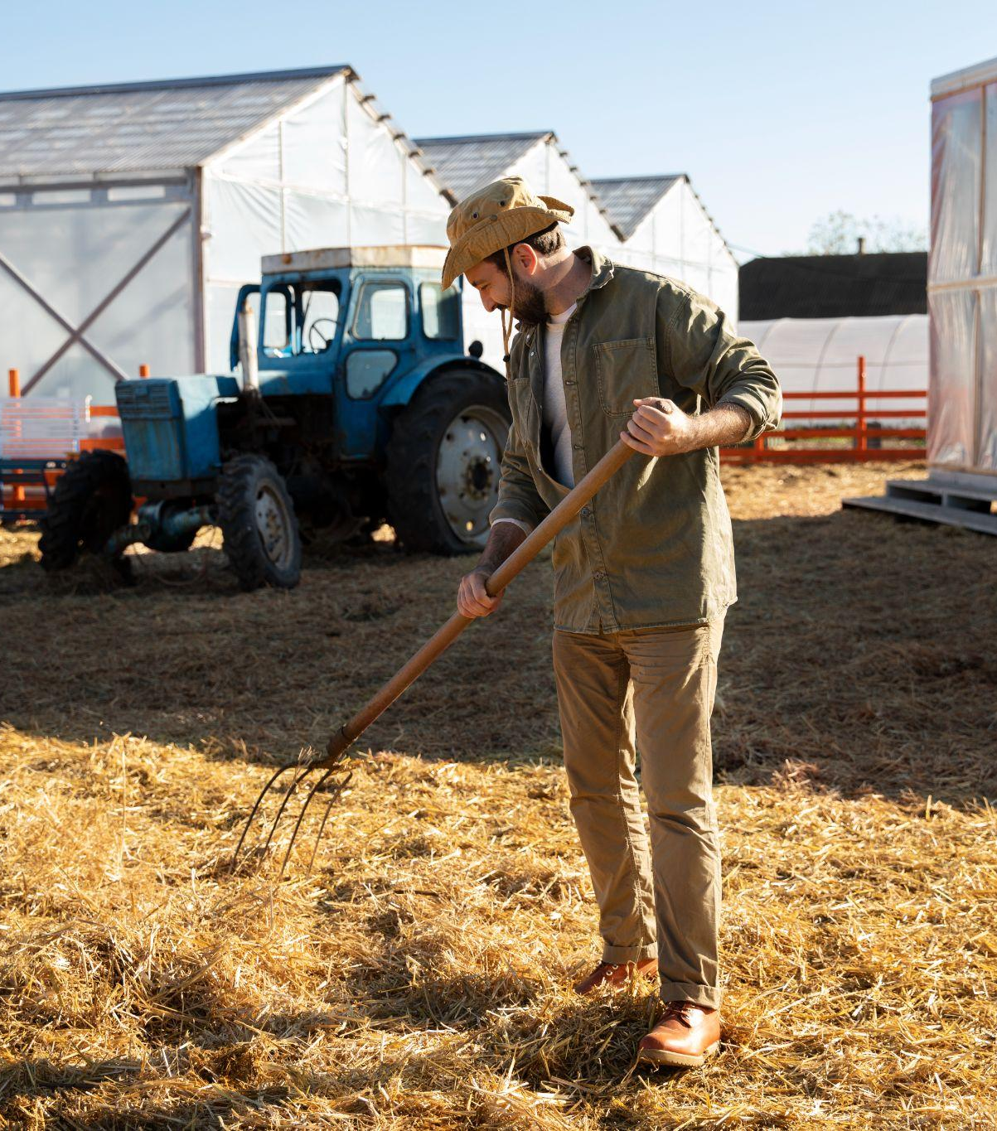
Introduction
"FARMIQ harnesses Earth observation data to precisely predict soil moisture, frost risks, water availability and yield quality, ensuring healthier crops."

Slide 4
How can we bring these insight to farmer communities in a timely manner?
Data Collection: Gathered relevant data from NASA satellite (MERRA-2) to support farmers' decision-making.
Predictive Modelling: Developed a CNN model to predict, Soil moisture, Frost risks, Water availability, Yield quality.
User-Friendly Interface: Created an intuitive interface using leaflet to get geolocation for tailored information.
Timely Access: Delivered real-time insights for immediate decision-making for farmers.

Slide 5
Implementation
MERRA-2 Satellite Data
Agricultural and water management data
Data pre -processing
Build CNN Model
Predict the output variables based on latitude and longitude
FLASK APPLICATION
Response
User input
Web application

Slide 6
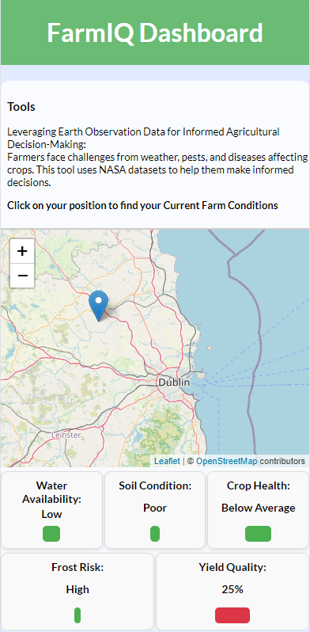
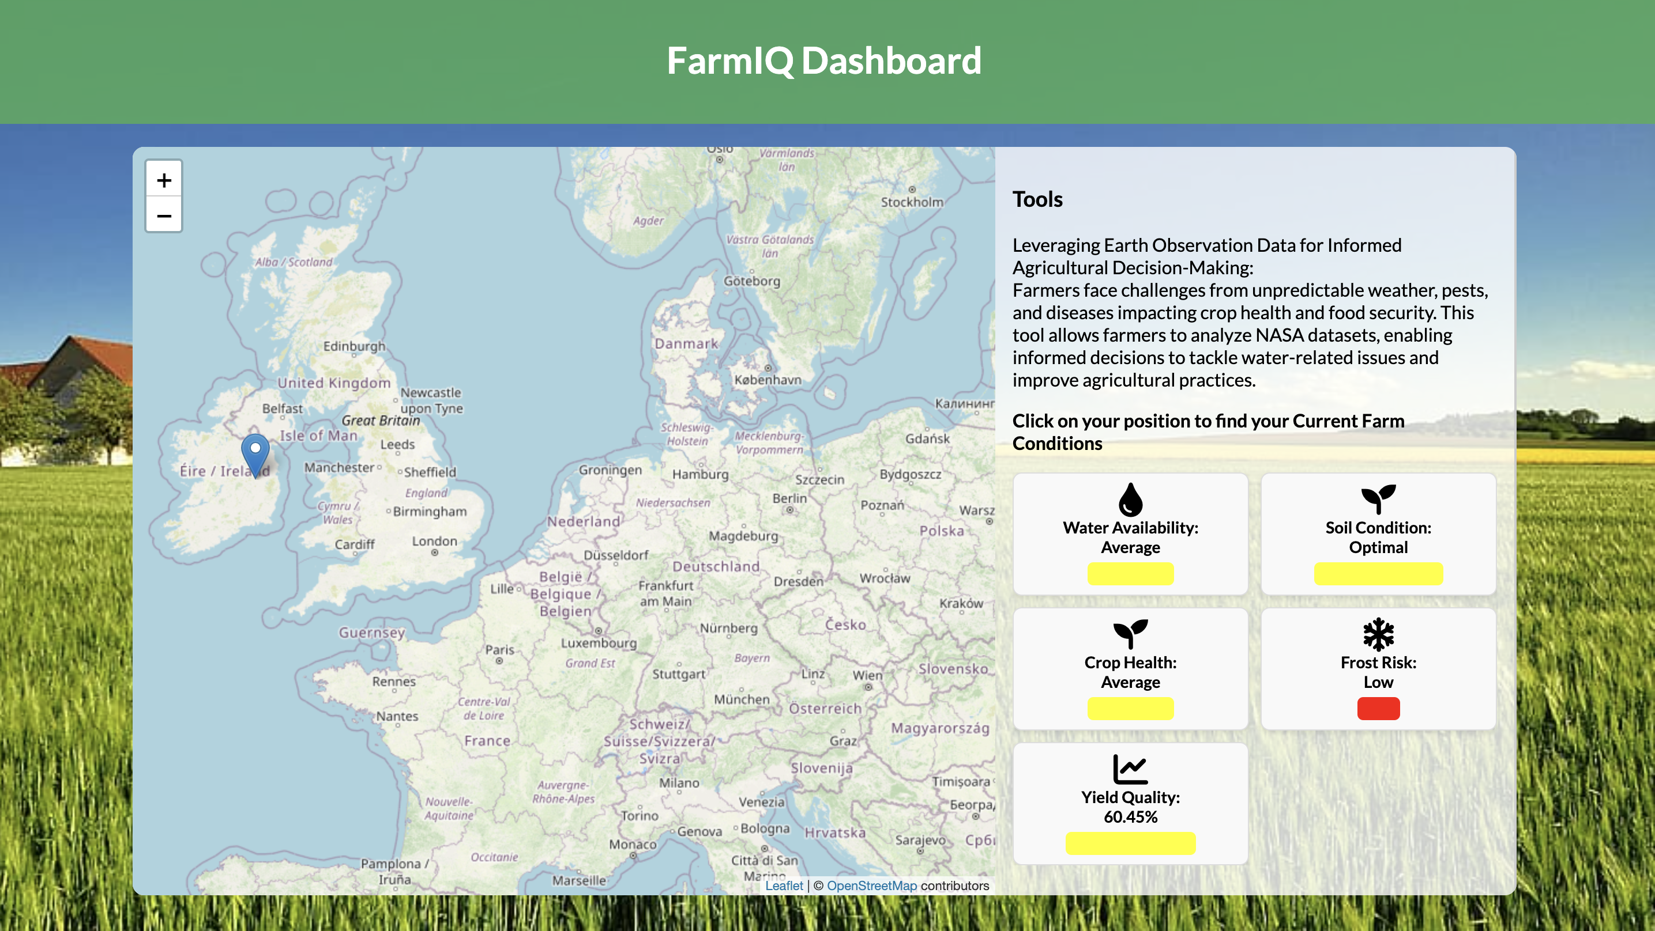
User Interface

Slide 7
Challenges faced:
Data Accessibility: Difficulty locating suitable datasets on the NASA website.
Data Format Conversion: Need to convert data from .nc4 to .csv for easier model training.
Model Deployment: Challenges in deploying the CNN model and integrating the endpoint with a public website (front-end and back-end).

Slide 8
Future Directions for Our Project
Seasonal planning based on yield quality helps farmers choose crop types and planting schedules.
Analyzing yield quality informs farmers of their crops' nutrient needs, enabling data-driven fertilizer decisions that enhance harvest benefits.
Expand the web application to incorporate data from other regions and provide global coverage.

